Slide 1
PERMANENT TISSUES
Simple permanent tissues
Complex permanent tissues
Parenchyma
Xylem
Chlorenchyma
Phloem
Aerenchyma
Collenchyma
Sclerenchyma
Surface tissue
We completed simple permanent tissues.
Now let us learn about complex permanent tissues

Slide 2
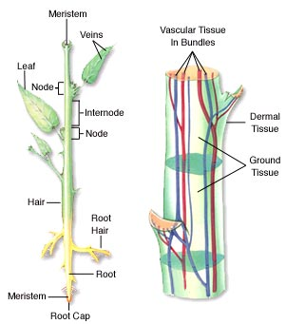
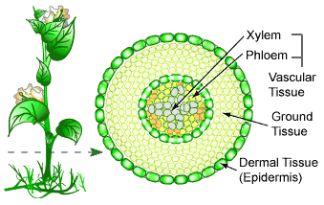
Complex permanent tissues
Complex tissues are made up of more than one type of cells.
The cells are in coordination with one another.
The complex tissue present in plants is vascular tissue or conductive tissue.
It is present in stem, roots, leaves.
Let us study vascular tissue in detail..

Slide 3
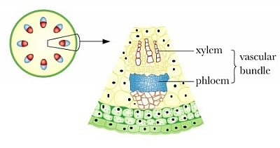
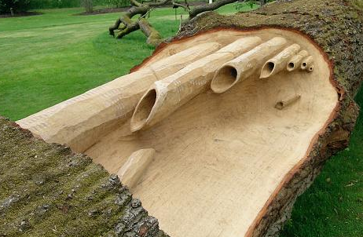
Vascular tissue
Vascular or conductive tissue is a distinct feature of complex plants.
Xylem and phloem are examples of vascular tissue.
Xylem conducts water where as phloem conducts food.
Xylem and phloem together constitute vascular bundle.
Special
Well developed
1. Xylem :
The cells of xylem are thick walled and many of them are dead.
They are of the following types

